Slide 1
AMAZON SEARCH QA TESTING
Ziming Wang(19814)
Jiajia(19771)
Ruichen Zhu(19811)

Slide 2
TABLE OF CONTENTS:
Introduction
Design
Environment
Identify and understand the problems
Investigate to find possible solutions which may include your own solutions.
Theoretically compare the solutions and select the best one.
Implementation
Answer how you did it this way.
Test
Conclusion

Slide 3
INTRODUCTION
Create and automation an End-to-End integration test case using Selenium Web Driver (Junit or TestNG).
Try as much as you have learned,
You should
A power point to brief describe your use case, automation design
A completed test case including detailed steps
Using Selenium WebDriver automation (Junit or TestNG framework) to automate all steps, should use all of the following:
1) Data Driven (Using data driven either from Excel sheet or BDD feature file);
Run test case from BDD Cucumber feature file or testNG xml for other data driven;
Generates testing report;
Takes Screenshot to take snapshot image;
(Optional) Log all test case steps;
Follow up Clean code compliance

Slide 4
ENVIRONMENT
Chrome Driver: 4.11.0 (July 31, 2023)
Operating System: Windows 11
Framework: Maven
Language: Java 8

Slide 5






SCOPE
End to End use case example – Holiday shopping
Open Amazon.com
Search your target good (for example, camera)
Find your model, color and compare price
Open Details, select Qty, and items for coming labor day good deal etc.
Decide purchase and buy

Slide 6
ENVIRONMENT
Chrome Version: 114.0.5735.90
Operating System: Windows 11 Home
Model: Dell G7
Framework: Selenium + Cucumber BDD + ExtentReports
Language: Java 8

Slide 7
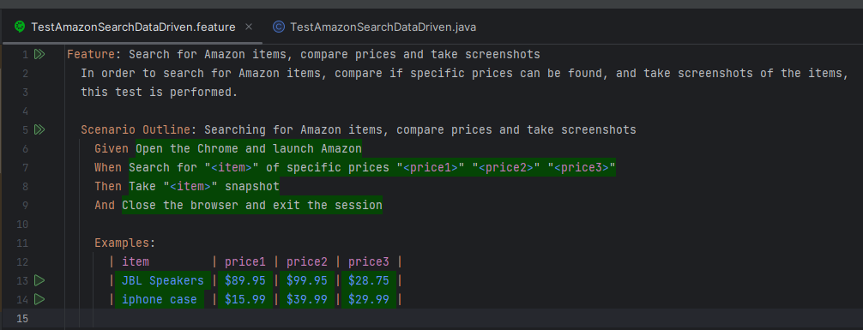
IMPLEMENTATION

Slide 8
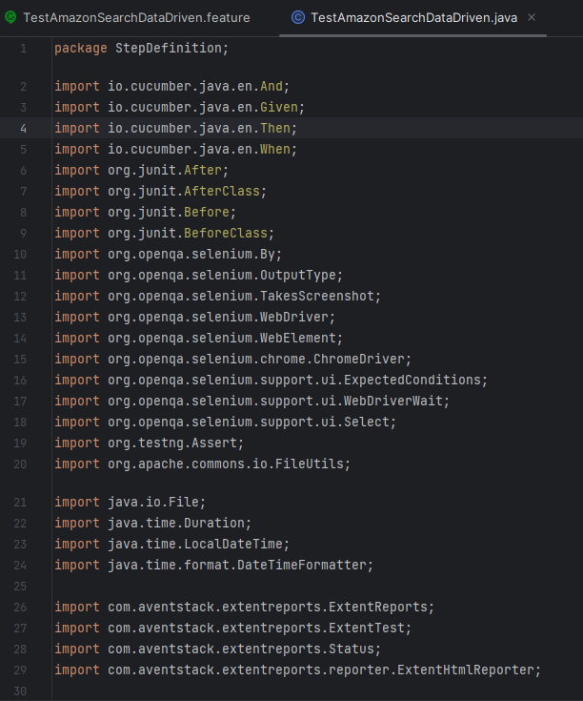
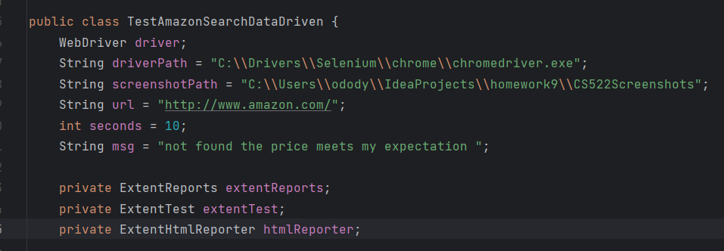
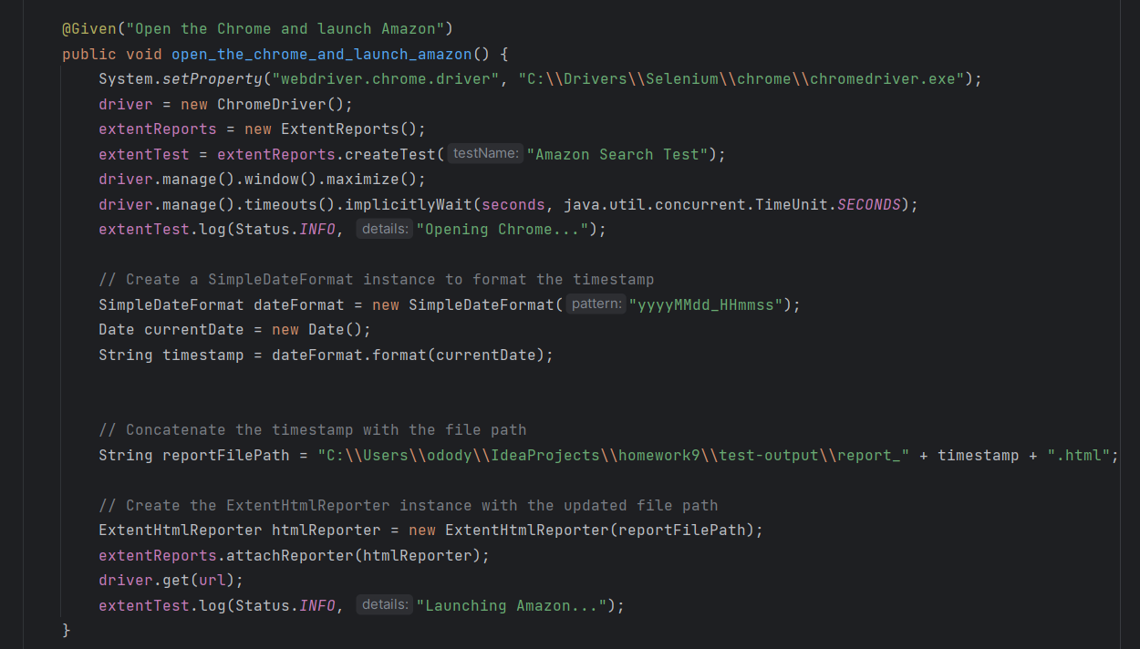
IMPLEMENTATION

Slide 9
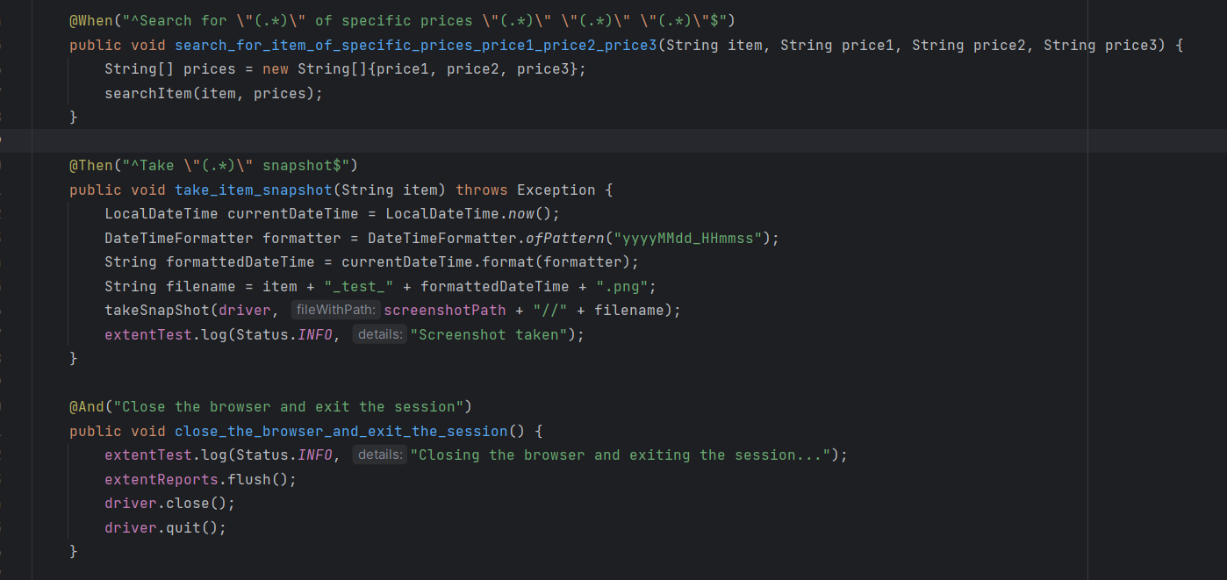
IMPLEMENTATION

Slide 10
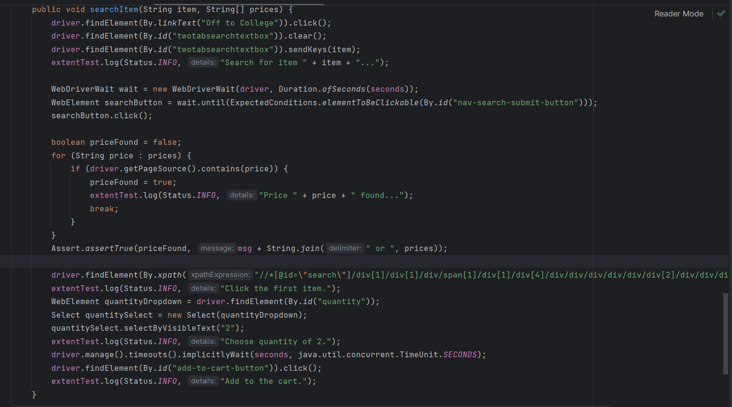
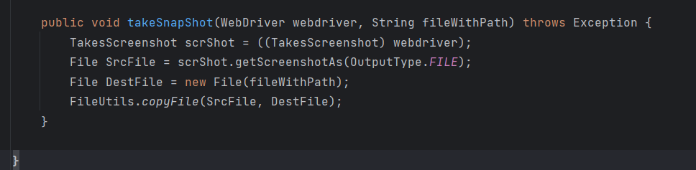
IMPLEMENTATION

Slide 11
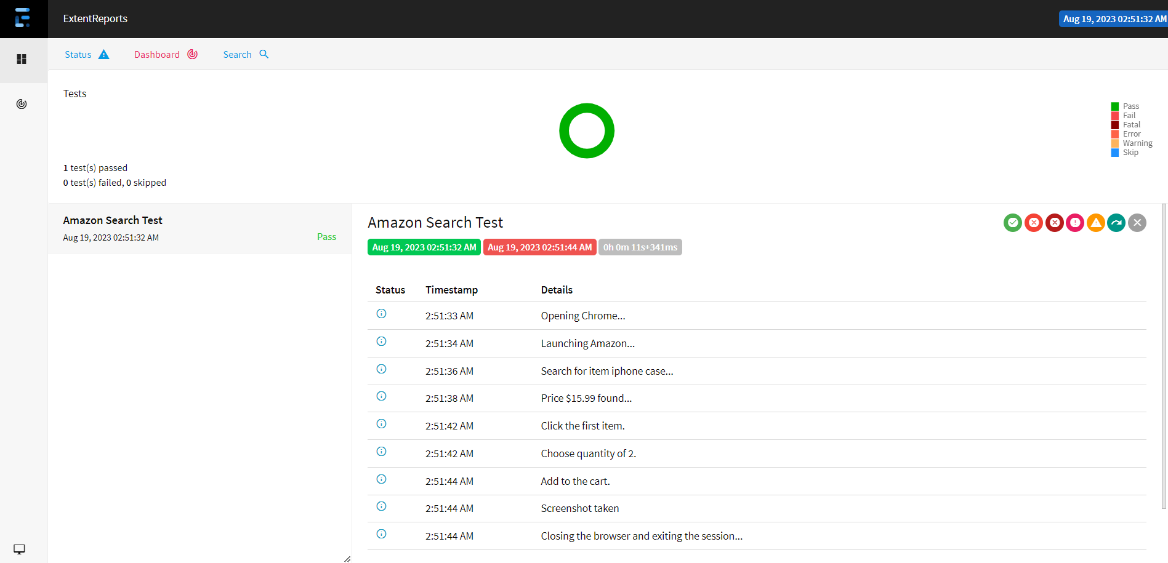

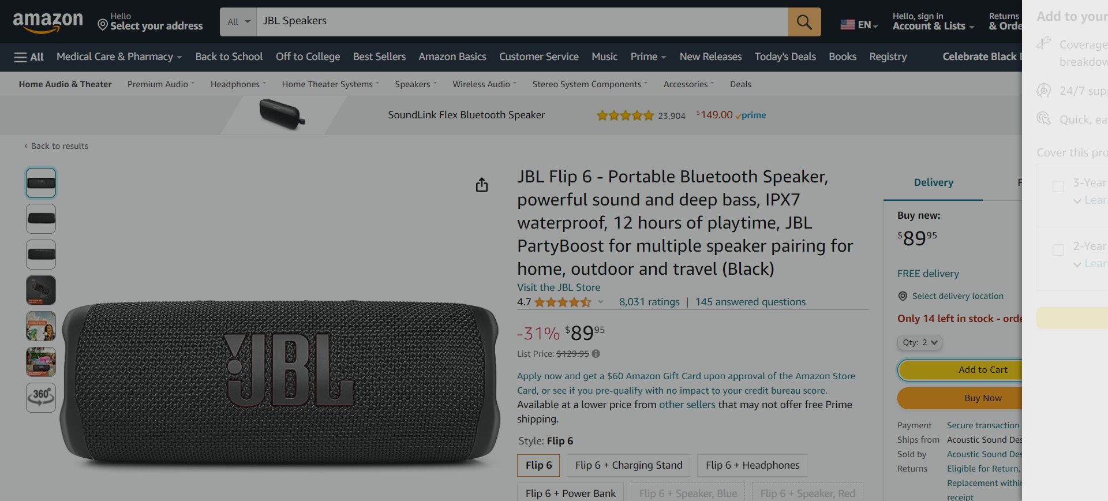
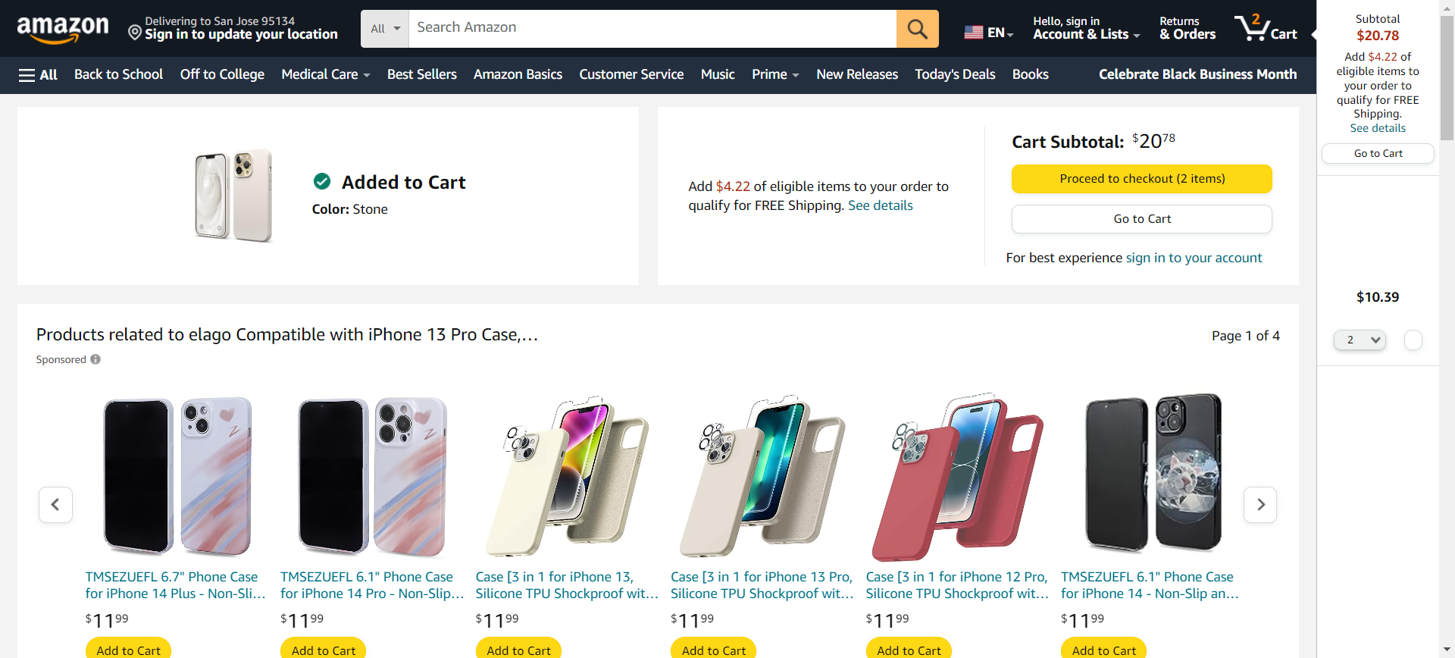
TEST RESULT

Slide 12
ENVIRONMENT
Chrome Version: 114.0.5735.90
Operating System: Mac OS 13.4
Model: 2020 M1
Framework: Selenium + TestNG
Language: Java 8

Slide 13
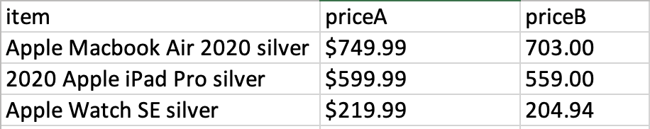
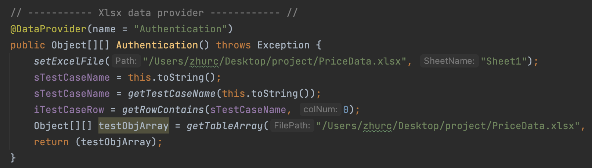
Data Driven: Excel

Slide 14
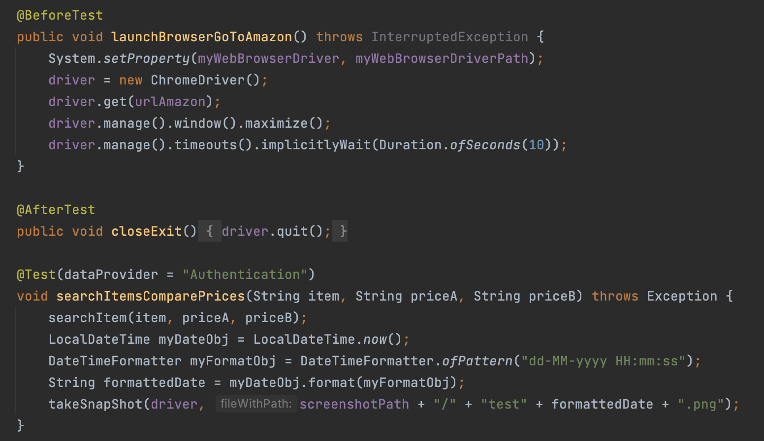
TestNG

Slide 15
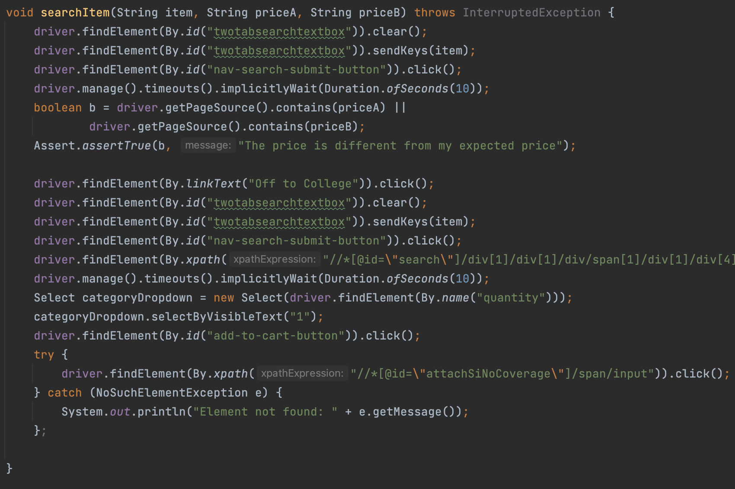
IMPLEMENTATION

Slide 16
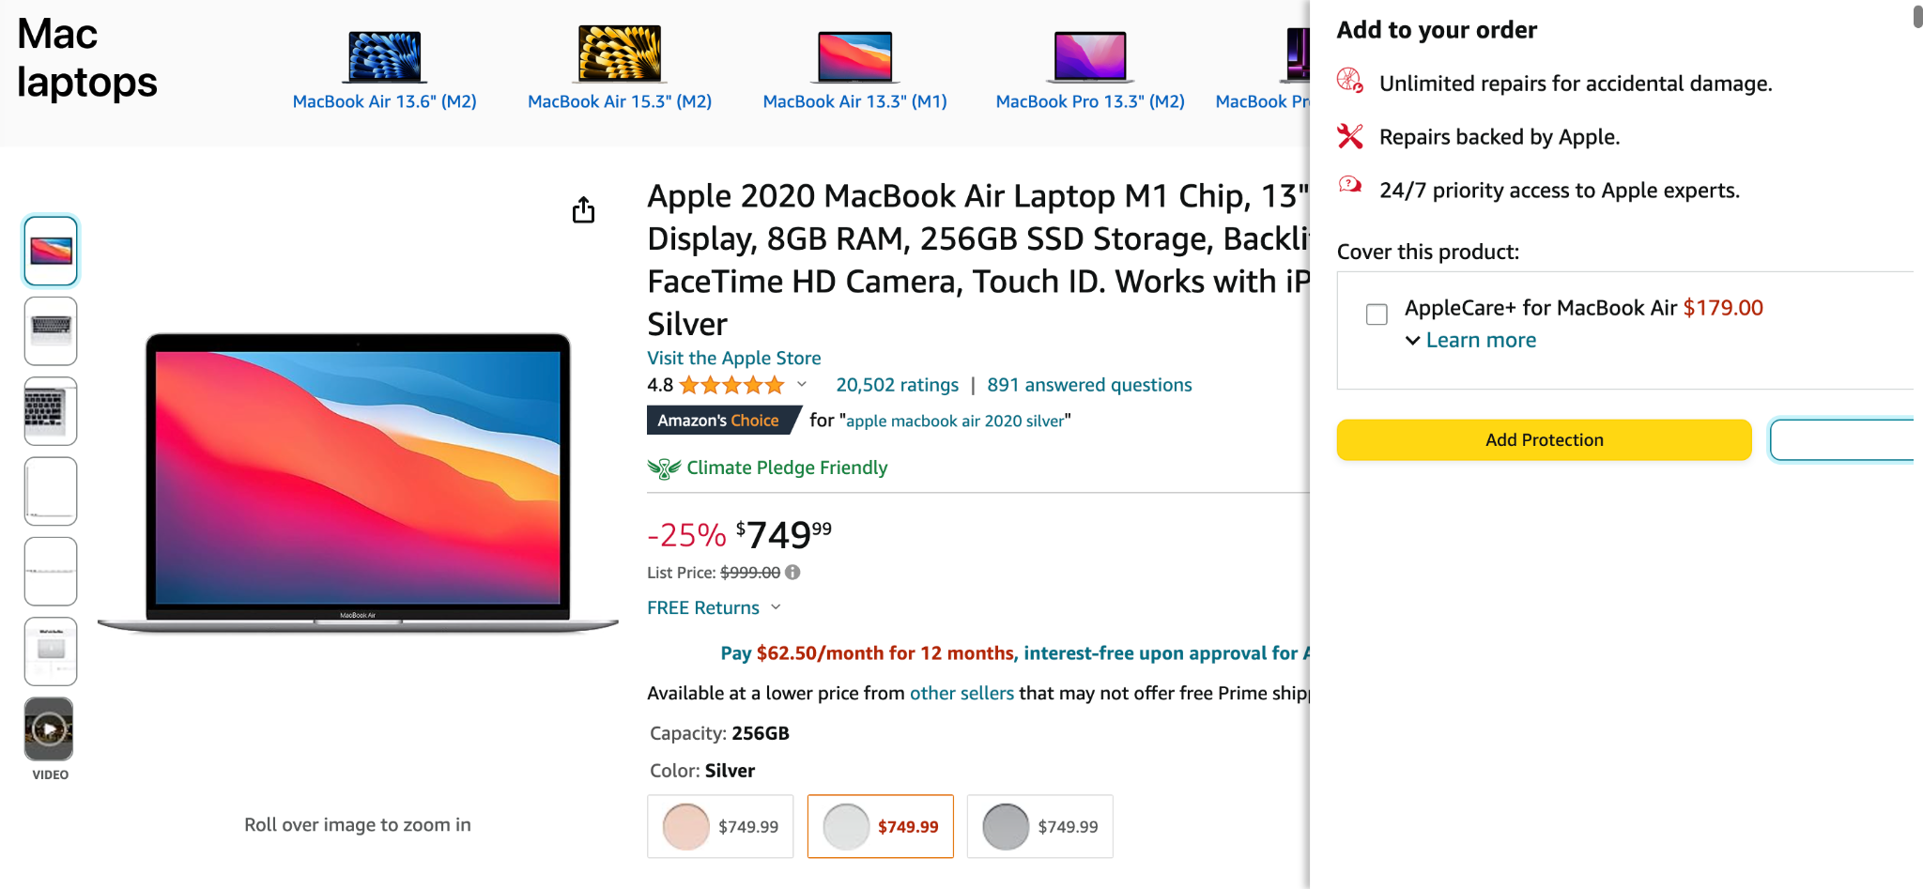
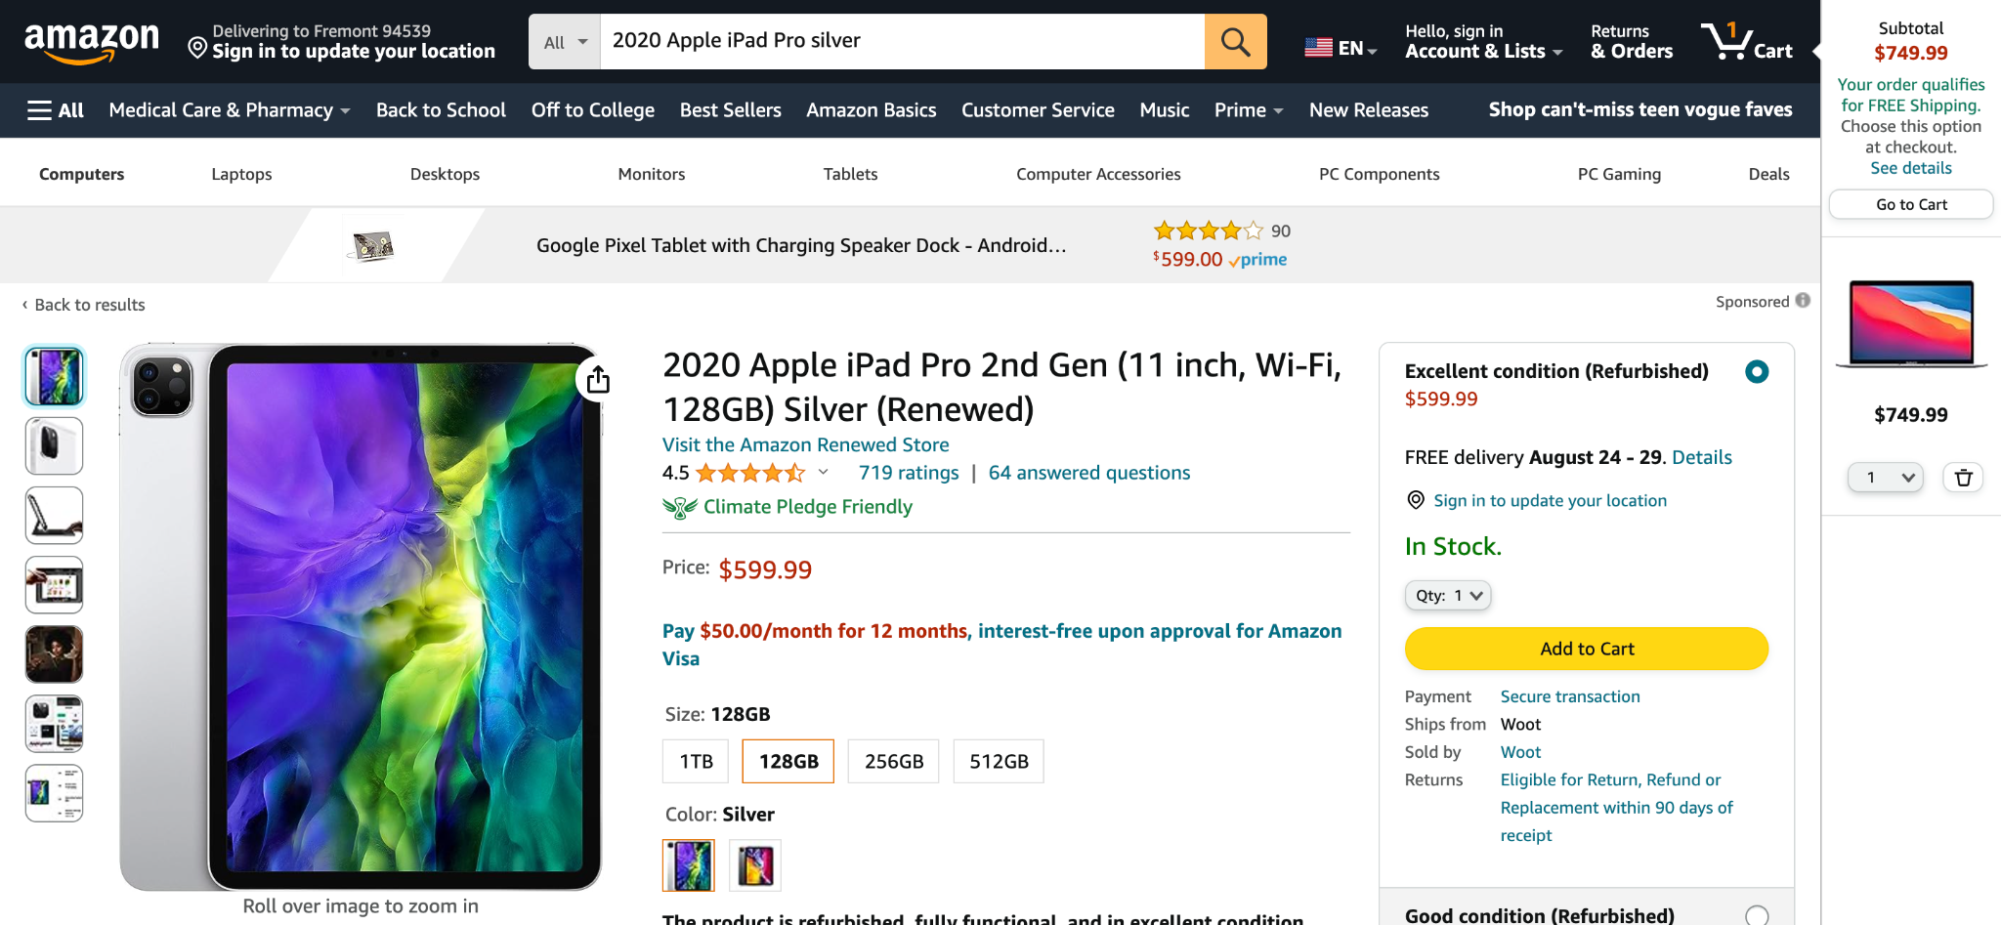
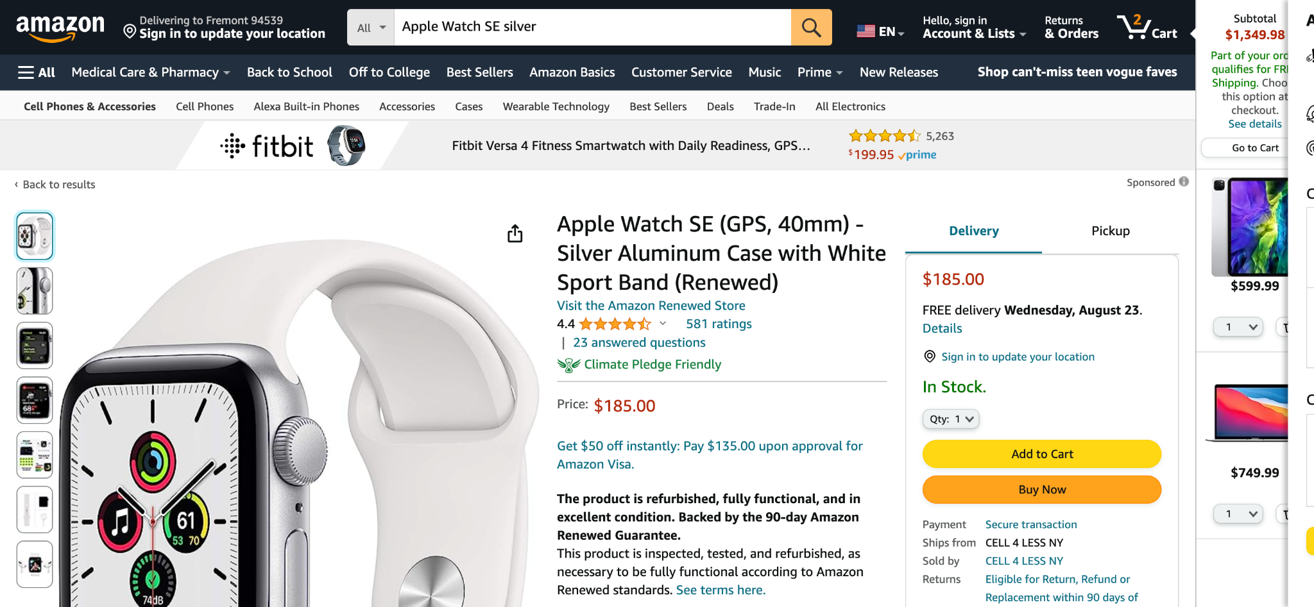
ScreenShots

Slide 17
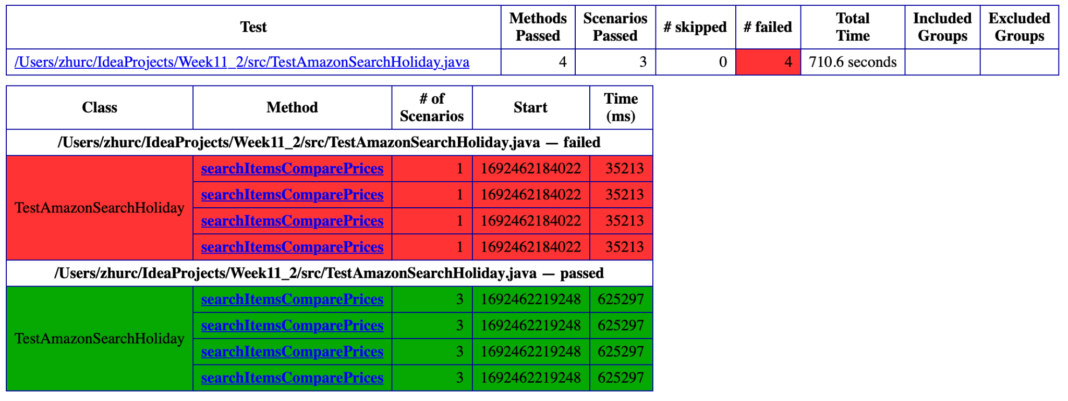
Test Report

Slide 18
IN CONCLUSION, WE AS A TEAM SUCCESSFULLY DESIGNED AND IMPLEMENTED THE QA TEST FOR AMAZON WEBSITE WITH AUTOMATICALLY GENERATED SCREENSHOTS AND HTML REPORT. THIS PRACTICE MADE US KNOW MORE ABOUT TESTNG AND SELENIUM FRAMEWORKS AND THE WORKFLOW OF AUTOMATION TESTING.
“
”
CONCLUSION

Slide 19
Q & A

Slide 20
THANK YOU
Ziming Wang
Jiajia Ding
Ruichen Zhu

